Slide 1
Credentials Program Training Webinar
May 12, 2025

Slide 2
Agenda
Introductions
Timeline
Policies
Program Resources
Eligible Learners
Eligible Costs
Reimbursement Calculation
Reimbursement Period Alignment
AidKit Platform Instructions

Slide 3
Timeline
5/12 Training Webinar 3–4 pm
5/13 Credential Help Desk 1-2 pm
5/20 Credential Help Desk 1-2 pm
5/26 Credential Closes (EOD)
6/4 Credential Submission Confirmation Sent
6/18 Approval of reimbursements at PDF board meeting
6/20 Reimbursements distributed via ACH: Payments hit bank accounts within two business days
6/25 Reimbursement Summaries and Feedback Survey Sent

Slide 4
Critical Policies
All expenses are submitted via AidKit online platform
Training Pathway Validation & Tier Determination
Training pathways that have not been submitted for validation are not eligible for reimbursement
We partner CEEMI to determine reimbursement tiers and specific rates
We encourage all SOs to upload expense verification documents. Beginning in fall of 2026 this will be required. Current Policy: SO is required to maintain all documents related to submissions for six years
All requests for reimbursement must be reviewed and confirmed by a second staff member at the Supported Organization before being submitted to PDF

Slide 5
Credentials Program Resource Page
Credentials Program Reimbursement Resources
Program Guidelines
Submission Resources

Slide 6
Eligible Learners
Be a Denver resident and/or graduated from a Denver high school (If over the age of 26, must provide Denver address)
Be thirty (30) years of age or younger as of the final scheduled class day of the academic year for which a reimbursement grant is requested
Learner must be born on or after August 1, 1993
Demonstrate a financial need (see guidelines)
Achieves Satisfactory Academic Progress
SAP is defined by your training program requirements and how you measure progress towards completing enough coursework to complete the program within a specific time period.

Slide 7
Eligible Costs
Costs of Training: A student’s costs of attendance or participation in a training program, including, but not limited to, tuition, fees, room and board, books and supplies.
In practice, this is the cost that would be transferred onto the learners should the SO not have funding to cover the costs of training and thereby defray the student’s cost of attaining the credential or certificate
Optional Support Services: Services designed to increase student persistence and completion that are not a required element of the training.
When in doubt about whether or not a cost is eligible, please refer to the guiding questions below:
Does the expense relate directly back to the learner’s training or a service they received while an active learner in your program?
Does the expense increase training persistence and credential attainment?
Does the service remove academic and/or non-academic barriers to training persistence and credential attainment?

Slide 8
Eligible Costs Examples
Cost of Training (required for all learners) | Optional Support Services (provided on an as-needed basis - Support Services Guide) | Indirect Costs (10% of combined cost of training & support services)
Tuition & Fees - Credentialing Exam Fees - Competition Fees - Instructor Wages (salary + fringe) | Education & Career Counseling | Occupancy: Rent/mortgage for facilities, security, utilities, and cleaning services.
Room & Board - Required Off-site Training - Funding/Subsidies to Aid in Program Persistence (provided to all learners) | Support Staff Wages (salary + fringe) | Professional Development not directly related to a specific pathway and necessary for instruction.
Books & Supplies - Curriculum Materials - Learning Technology & Platforms - Labs/Clinicals Equipment & Supplies - Training Equipment | Emergency Funding/Subsidies to aid in program persistence (i.e. transportation, rent, groceries, etc.) | Depreciation and amortization costs of purchased vehicles
Training of Staff necessary to be effective in pathway instruction (i.e. conferences, professional development, in-service, etc.) | Technology not required for program (i.e. laptops) | Meals for staff training
 | Learner Networking Events
 | Mental Health Resources (for learners)

Slide 9
Total Reimbursement Amount Calculations
Total Personnel Expenses
Total Direct Operating Expenses
Submitted Costs
+
=
Submitted Costs
10% of Submitted Costs
Total Eligible Expenses
+
=
Total Eligible Expenses
Total Learners Supported
Average Cost of Training + Support Services per Learner
/
=
Average Cost of Training + Support Services per Learner
Learner’s Reimbursement Rate
Total Reimbursement for Learner
x
=

Slide 10
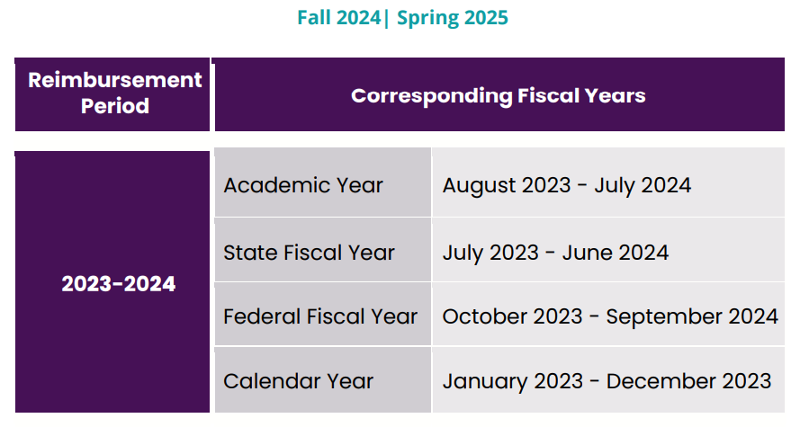
Reimbursement Periods

